Slide 1

GitHub
Lior Levy

Slide 2


Introduction
Git is a version control system used for tracking changes in computer files. It is generally used for source code management in software development. Git is used to tracking changes in the source code. The distributed version control tool is used for source code management.
GitHub is a website and cloud-based service that helps developers store and manage their code, as well as track and control changes to their code.
It simplifies the process of collaborating on projects and provides a website, command-line tools, and overall flow that allows developers and users to work together. GitHub acts as the “remote repository”

Slide 3


Features

Slide 4

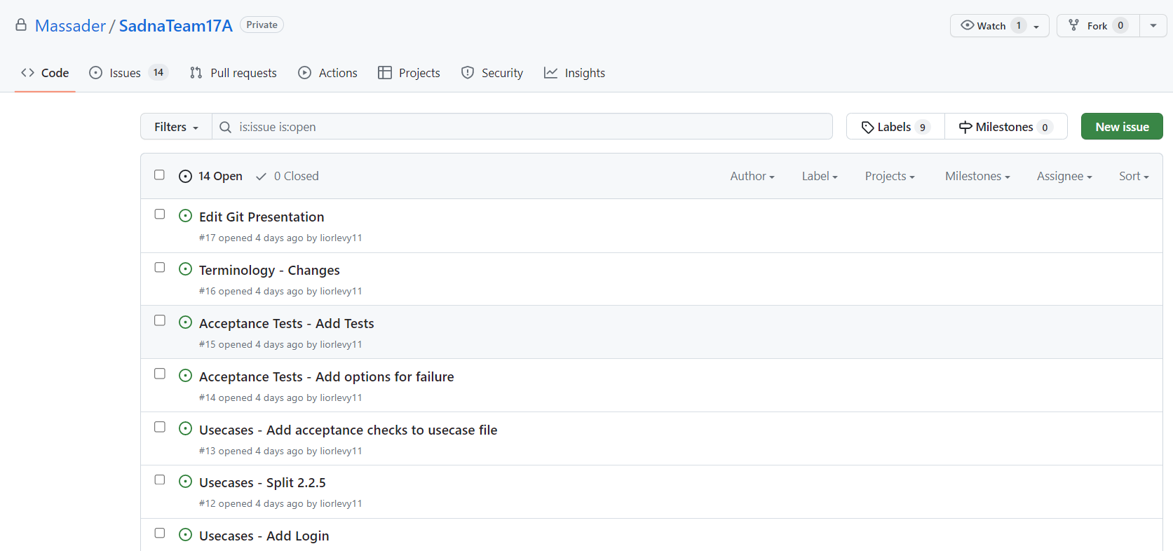
Issues
Issues let you track your work on GitHub, where development happens. When you mention an issue in another issue or pull request, the issue's timeline reflects the cross-reference so that you can keep track of related work. To indicate that work is in progress, you can link an issue to a pull request. When the pull request merges, the linked issue automatically closes.

Slide 5
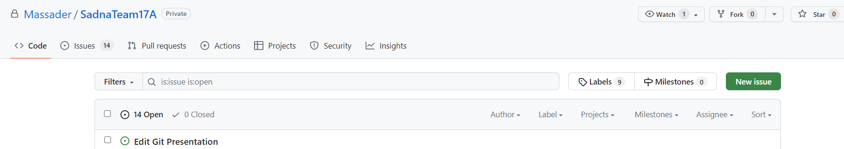
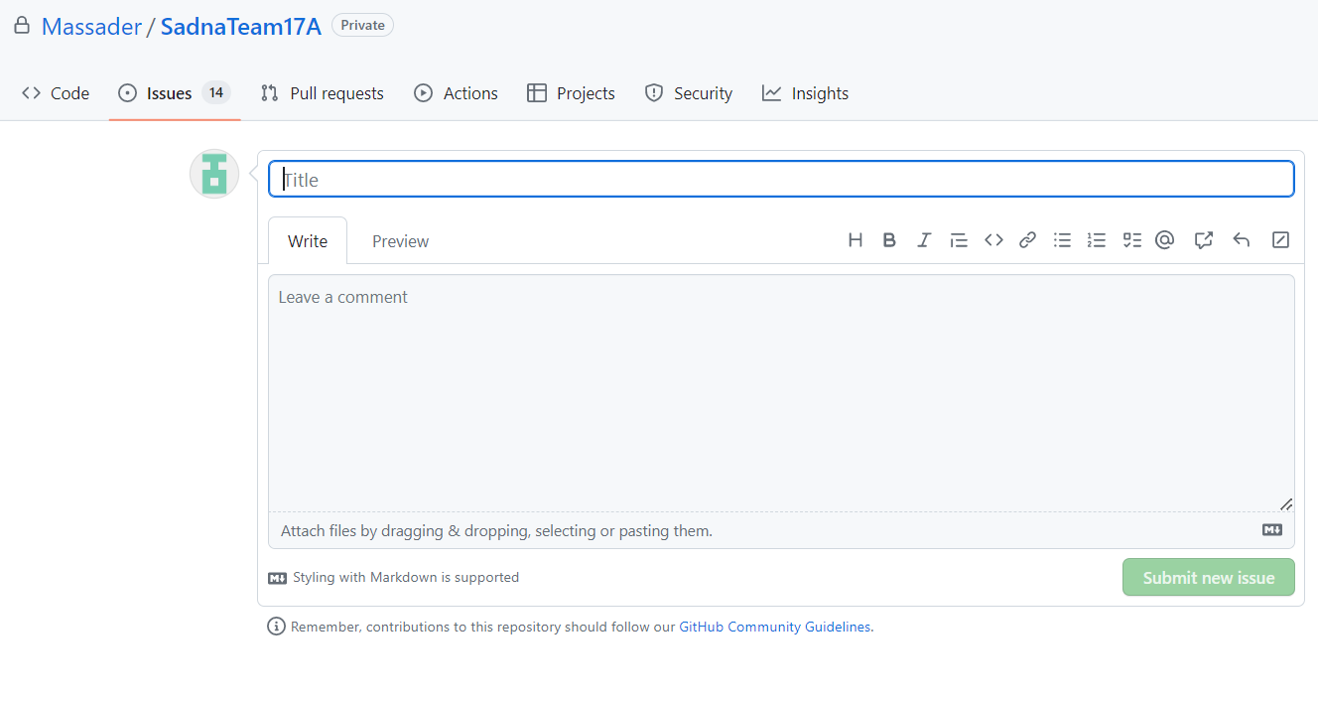
Issues EXAMPLE - create
new issue
Create a checklist
Mention other user/team
Describe the issue
comment issue
submit issue

Slide 6
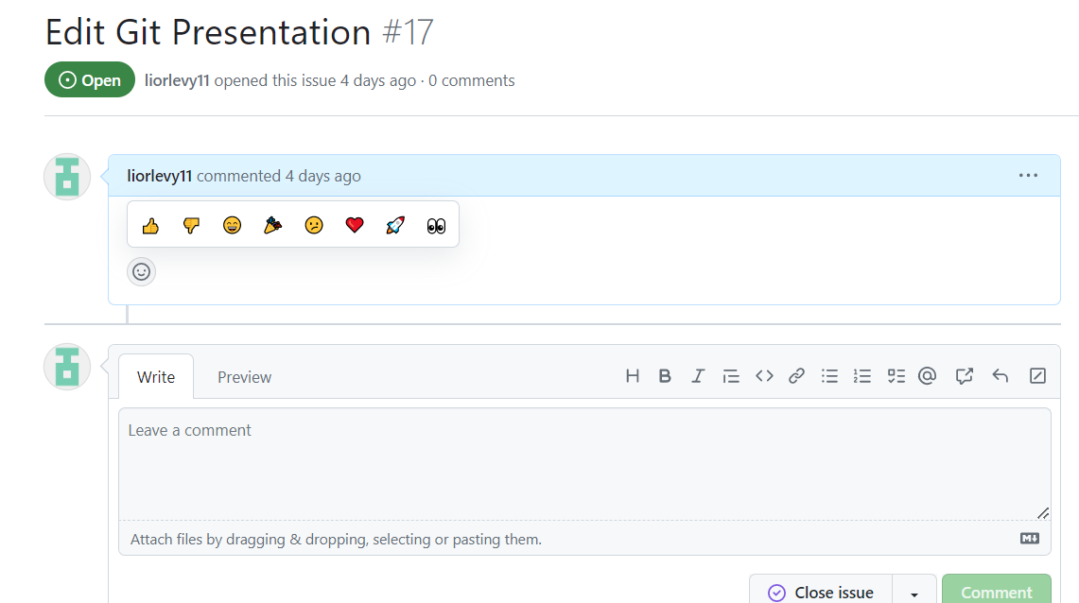
Issues EXAMPLE - after create
Example issue
react to an issue
Comments can be made and viewed

Slide 7
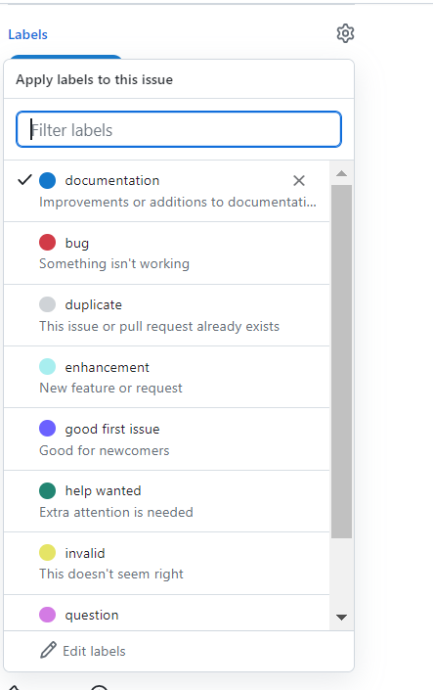
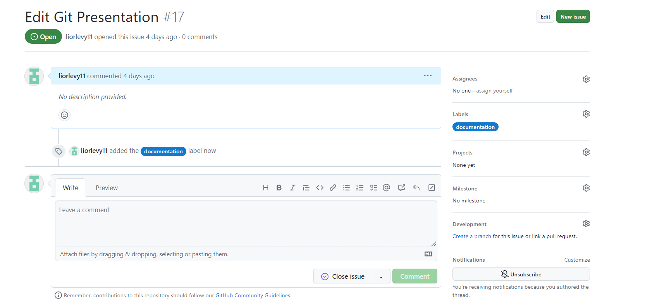
Issues EXAMPLE – add label
You can create or use existing labels to tag issues in order to make it easier for other users to classify the subject of the issue.
Labels can also be used as a way to annotate an issue with custom parameters such as: priority, status, effort, etc.
You can create new labels, edit existing or delete labels.
add label

Slide 8
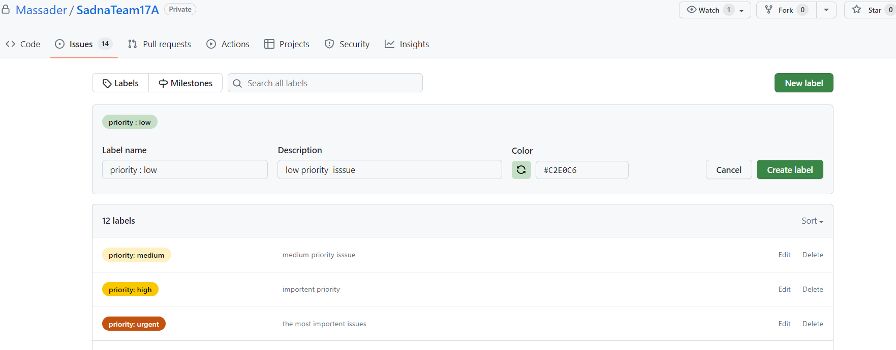
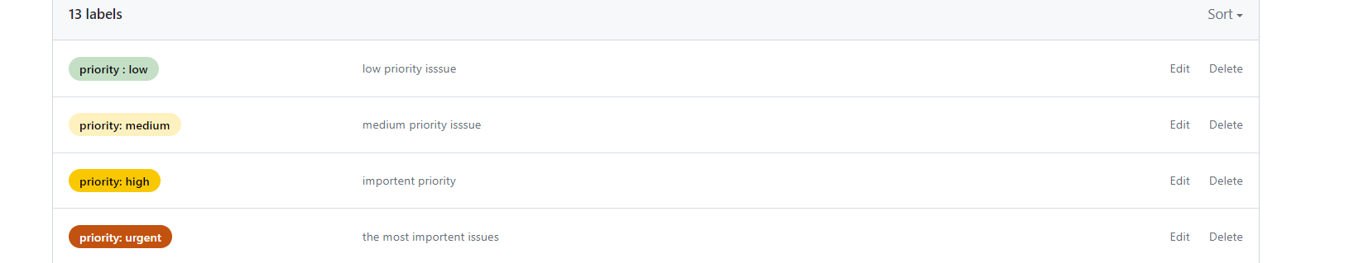
Using labels to priority issues
create labels that will describe the priority of the issue

Slide 9
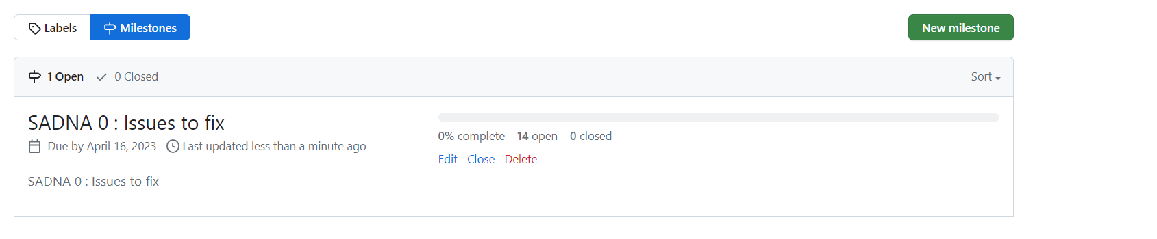
Milestone
Collections of Issues and Pull Requests for a particular release or project.
Can have a due date
You can use milestones to track progress on collection of issues and pull requests in a repository.
You can schedule a due date on a milestone.
When you create a milestone, you can associate it with issues and pull requests.
To better manage your project, you can view details about your milestone. From the milestone page.

Slide 10
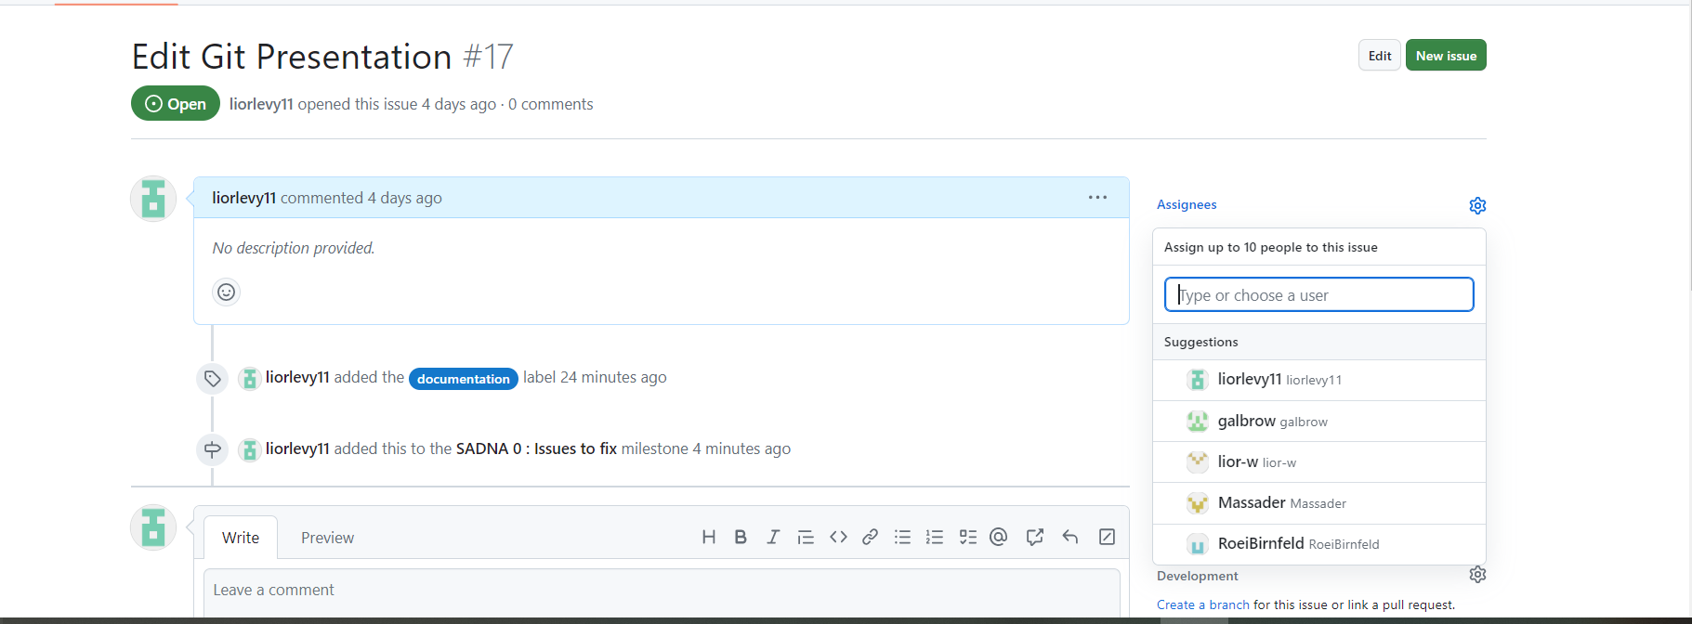
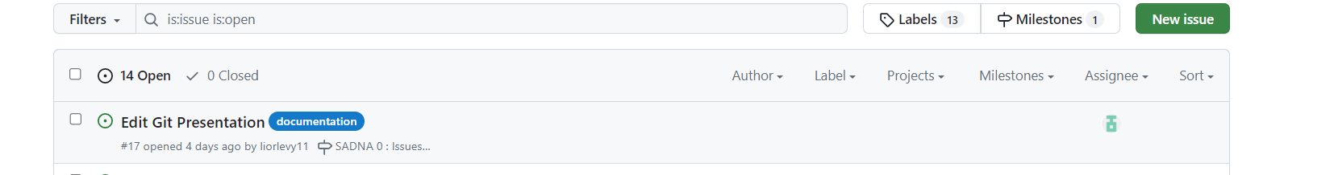
Assigning tasks to team members
Assigning team members to an issue
You can view/filter assignees for each issue

Slide 11
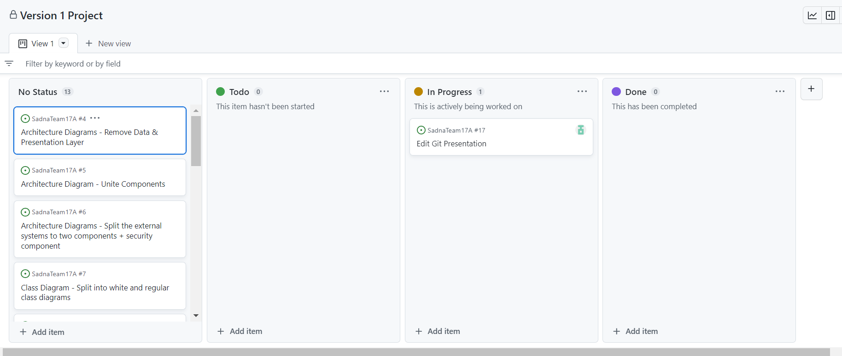
projects
A project is a customizable spreadsheet that integrates with your issues and pull requests
You can customize the layout by filtering, sorting, and grouping your issues and PRs. You can also add custom fields to track metadata
Each teammate can have its own project, with his assigned issues
There is an option of automated triggers – triggers that automatically move tasks around
https://docs.github.com/en/issues/planning-and-tracking-with-projects/learning-about-projects/quickstart-for-projects
Use projects to track progress

Slide 12
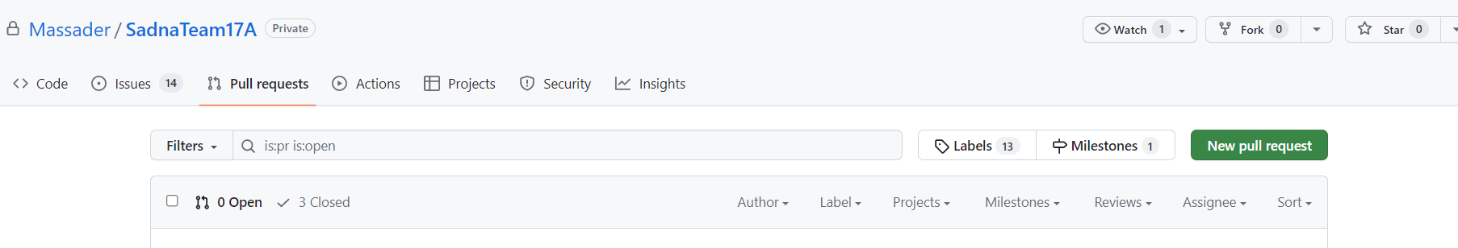
Pull requests
Pull requests let you tell others about changes you've pushed to a branch in a repository on GitHub. Once a pull request is opened, you can discuss and review the potential changes with collaborators and add follow-up commits before your changes are merged into the base branch. We have:
1. Pull Request from a forked repository
2. Pull Request from a branch within a repository
We can link an issue to a pull request in order to trace changes made to relevant code or tests added in order to handle the requirement associated with that specific issue.
Add new pull request

Slide 13
Traceability between requirements to code
Pull request associated with an issue (with relevant changes to code) can be viewed through the project board.
We can also view the pull requests associated with the issue from the issues page.

Slide 14
Notification
GitHub offers notifications for events that take place within a given workflow. These notifications are managed by your preferences. You can subscribe to all issue creations and edits on a project, or you can just receive notifications for issues in which you are mentioned. You can also decide on which platform to receive the notifications
For example Review requests by pull request - If you’re on the other side of the code, requesting peer reviews is easy. Add users to your pull request, and they’ll receive a notification letting them know you need their feedback.
Code reviews and pull requests

Slide 15
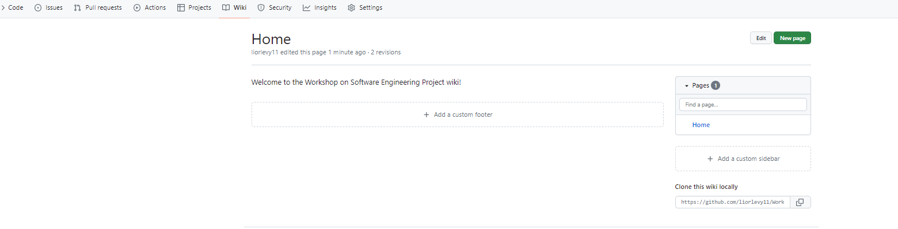
Wiki
With wikis, you can write content just like everywhere else on GitHub. by use open-source Markup library to convert different formats into HTML, so you can choose to write in Markdown or any other supported format.
You can use Markdown to add rendered math expressions, diagrams, maps, and 3D models to your wiki. Every GitHub repository comes with a section for hosting documentation, called a wiki
We can use this to provide detailed information about the project - its design, its purpose, and its goals
It can also include any other additional documentation that will help others use and contribute to the project

Slide 16

GitHub Code Flow

Slide 17

GitHub Code Flow
1
2
3
Create a branch: Create a branch with a short and descriptive name. By creating a branch, you create a space to work without affecting the default branch. Additionally, you give your collaborators a chance to review your work
Make changes: On your branch, make changes to the repository. Your branch is a safe place to make changes. If you make a mistake, you can revert your changes or push additional changes to fix it. Add, commit (with a meaningful comment) and push your changes. Repeat until finish
Create a pull request: Create a PR to ask for your collaborators for feedback. You can also require an approving review before PR can be merged. If you want it to be quick, you can mark it as draft. PR includes summary, the problem it solves, images, tables and even linked issues
Address review comments: Reviewers should leave questions, comments, and suggestions. You can continue to commit and push changes in response to the reviews. Your pull request will update automatically
Merge your pull request: Once your pull request is approved, merge your pull request. This will merge your branch to the default branch. GitHub retains the history of comments and commits in the PR to help future contributors understand your changes.
Delete your branch: After you merge your pull request, delete your branch. This indicates that the work on the branch is complete and prevents you or others from accidentally using old branches.
4
5
6

Slide 18
GitHub Project Workflow
Create
Create a new project
Configure
Configure your project board to automate columns (new issues are placed in the “to-do” column, etc.)
Create
Create a new milestone
Create
Create issues/pull requests and associate them with the relevant milestones & projects
Work by
Work by GitHub code flow

Slide 19
Summary
One of the biggest advantages of Git is its branching capabilities. Unlike centralized version control systems, Git branches are cheap and easy to merge. This facilitates the feature branch workflow popular with many Git users. and have a lot of Useful features

Slide 20
Thank you

